Slide 1
Secure Transportation Management System using Edge
Computing for smart city: Challenges and Future Implementations
Group Members:
Shishir Kumar Das - 23366019
Maymuna Rukaiya - 23266019
Khairun Nisa - 23266001
Mahdi Hossain - 20301194
Instructor: Annajiat Alim Rasel
RA: Ehsanur Rahman Rhythm
ST: Farah Binta Haque
Team No: 30

Slide 2
Abstract
The increasing levels of urbanisation and population
In response, the idea of a "smart city" makes use of technology
An essential element of a smart city is a secure transport management system
The difficulties and possible uses of edge computing
The research has the potential to enhance the standard of life for citizens of modern cities

Slide 3
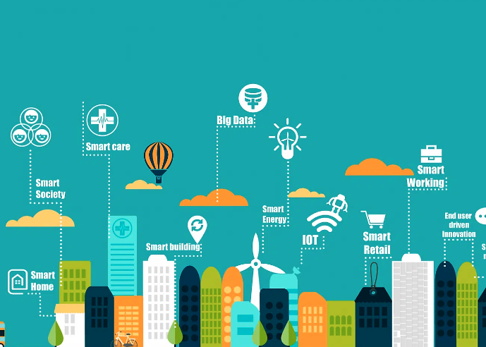
Introduction
Urbanization and population growth make transport network management challenging.
Smart cities use technology to improve service effectiveness and adapt to resident needs.
A secure transport management system is crucial for a smart city.
Edge computing can enhance transportation systems by enabling real-time data processing and decision-making.
Intelligent Transportation Systems (ITS) manage traffic flow, reduce congestion, and enhance safety.

Slide 4
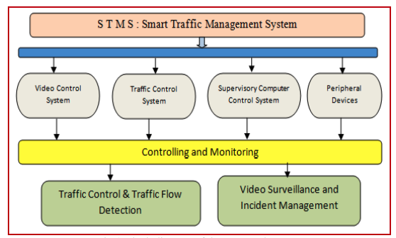
Introduction
Deep learning techniques are being used to predict autonomous vehicle behavior.
Edge computing can assist autonomous driving and provide real-time traffic information.
Challenges to incorporating edge computing into transport systems include resource management, interoperability, and data security.
Smart Transport Management Systems (STMS) are crucial for effective and secure commuting in smart cities.
STMS utilize technologies such as edge computing, IoT, and blockchain to manage traffic flow, reduce congestion, and enhance safety.

Slide 5
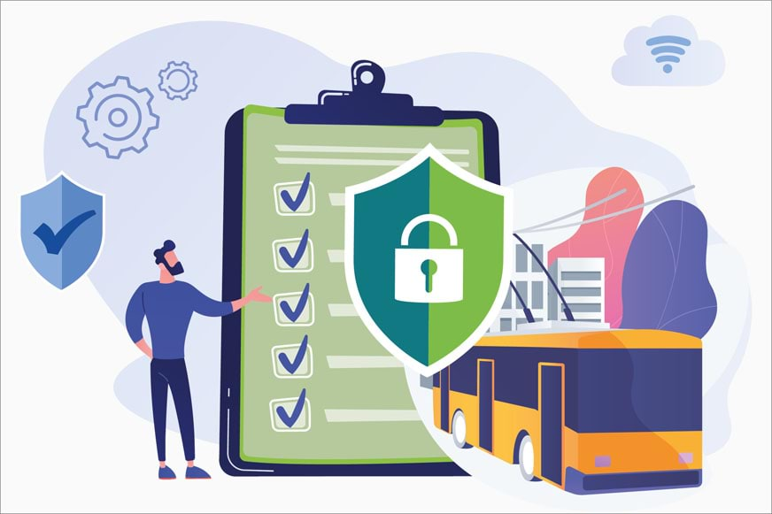
Literature Survey
Security Trends in the Transportation Industry by IBM X-Force Research report
Between March 1, 2015 and May 15, 2016, over 44 percent of attacks successful
Cyberattack on automobile equipped with a ”U-connect” in-vehicle networking device
Got the ability to remotely control a Jeep and drive it off the road
Faulty Mobileye EyeQ 3 device in Tesla vehicles
Turning 35 mile per hour road sign to an 85 mile per hour sign
x

Slide 6
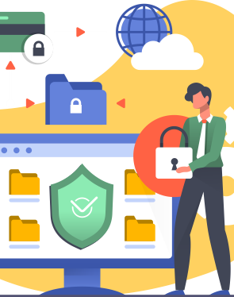
Literature Survey
Hackers target Jeep Cherokee in 2018
Take control of the car’s steering, brakes, and engine gearbox using a Wi-Fi or cellular connection
14 security flaws in many BMW cars by Researchers
physical access to the car and remote vehicle hacking
Gigabit-speed networking to smart vehicle by Cisco
Broaden the scope of an assault on a smart vehicle due to higher bandwidth capabilities

Slide 7
Methodologies
4 Architecture we will use to model our edge computing system and enhance safety.
Edge Computing Architecture
Blockchain for Data Integrity
Internet of Vehicles (IoV) Architecture
Zero Trust Security Model

Slide 8
Methodologies
Edge Computing Architecture:
Deploy edge computing devices on vehicles and at key roadside infrastructure points.
Implement local processing for real-time data such as traffic flow, vehicle health, and environmental conditions.
Enable local decision-making to improve system responsiveness.
Blockchain for Data Integrity
Use blockchain to create an immutable and tamper-resistant ledger for critical data.
Timestamp data entries on the blockchain to establish a transparent and traceable record of events.
Integrate smart contracts for automated and secure execution of predefined actions.

Slide 9
Methodologies
Internet of Vehicles (IoV) Architecture
Establish a vehicular communication network for seamless communication
Implement Vehicular Cloud Computing (VCC) to offload computational tasks to the cloud and enhance data sharing capabilities.
Use IoV for collaborative decision-making, such as dynamic route optimization and traffic management.
Zero Trust Security Model
Adopt a Zero Trust approach by verifying the identity of users, devices, and systems before granting access.
Implement strong authentication mechanisms for edge devices, vehicles, and users.
Employ micro-segmentation to restrict lateral movement within the TMS network.

Slide 10
Data Type
One potential project using this dataset could be to build a predictive maintenance model for traffic management systems.
By analyzing the patterns and trends in the data, machine learning algorithms could be trained to predict when an engine is likely to require maintenance or repair for the security system.
The dataset could include various features and measurements related to the engine health of vehicles, traffic flow, environmental conditions and blockchain data, such as engine RPM, temperature, pressure, and other sensor data.
A massive amount of data, namely, big data or traffic data, is gathered from various sources.
However we only found three types of data

Slide 11
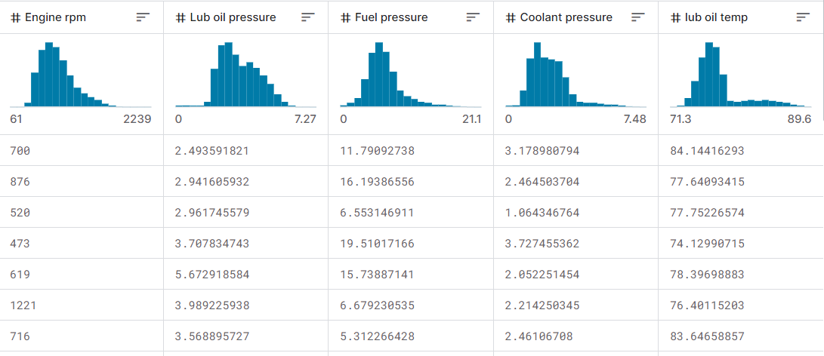
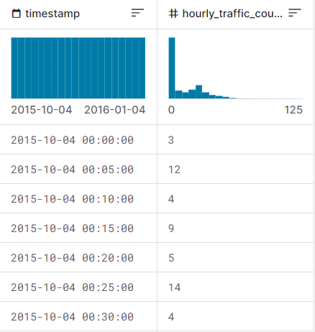
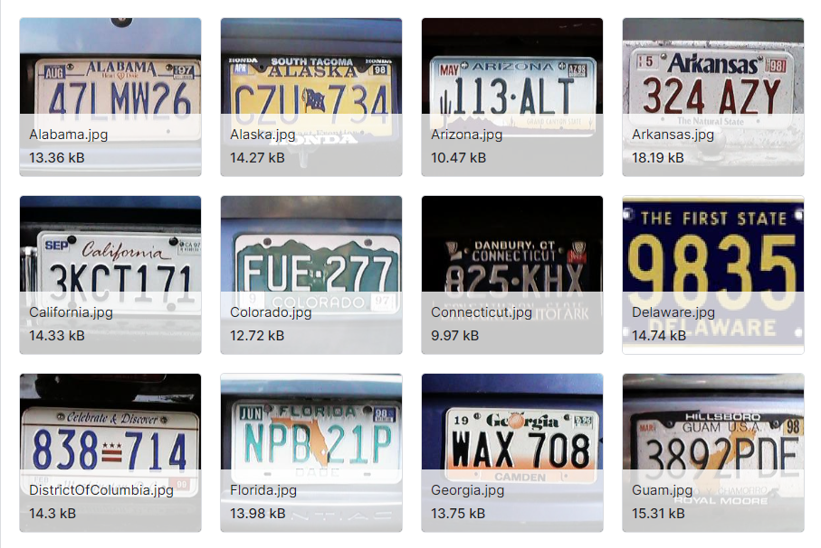
Datatype
Health of Vehicles
Traffic Flow
Number Plate :

Slide 12
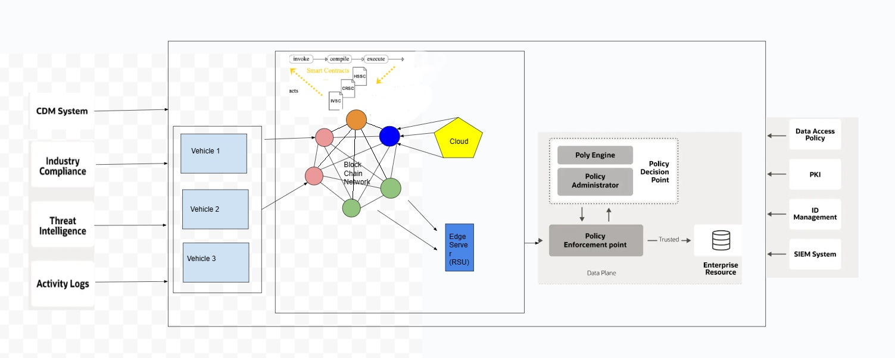
Prototype

Slide 13
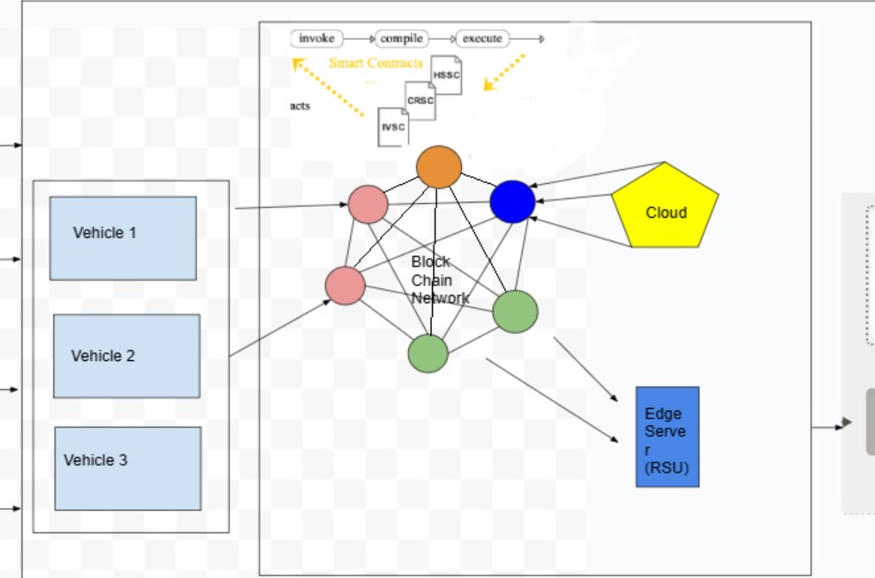
Edge Computing Architecture Layer
Edge devices are the vehicles, sensors, cameras, and other smart objects that communicate with each other and the edge servers using various wireless technologies, such as WiFi, Bluetooth, 5G, etc.
Edge servers are the local computing nodes that process and store the data from the edge devices, as well as provide services and applications to them.
Blockchain for Data Integrity
Blockchain network is the distributed ledger that records and verifies the transactions and events that occur in the system, such as vehicle movements, traffic signals, road conditions, etc.
The vehicles, cloud servers using computing nodes and Edge servers are connected to the blockchain network.

Slide 14
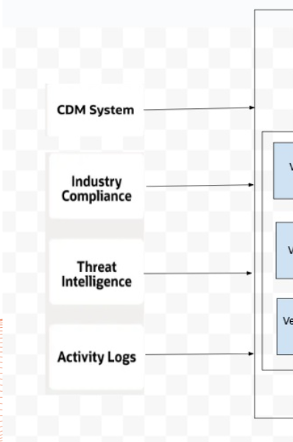
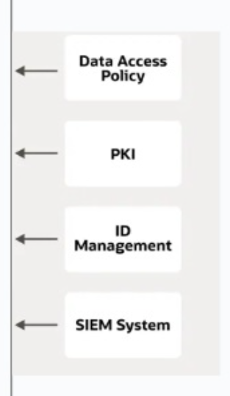
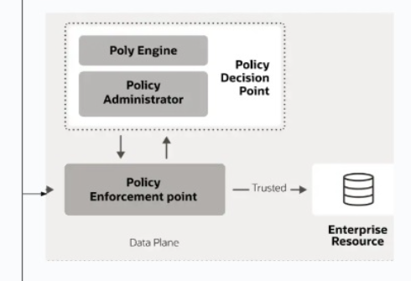
Zero Trust
Continuous Diagnostics and Mitigation (CDM) systems provide real-time monitoring and management of security postures within a smart transport system.
Industry compliance involves adhering to various regulations and standards that ensure the safety and security of the transportation infrastructure.
Threat intelligence in smart transportation systems involves gathering and analysing information about potential or current threats that could impact the system.
Activity logs in smart transport systems record and store information about all system activities, such as vehicle movements, sensor data, and user interactions.
Zero Trust Model requires Data Access Policy, PKI, ID Management of the vehicle owners and SIEM system in order for the model to work properly.
The Policy Engine of the Zero Trust security model is responsible for making decisions like granting or denying access to a particular transport resource based on the input it receives.
The Policy Administrator acts as the executor function of the Policy Engine. It establishes, maintains, and terminates sessions between the subject and the resource.

Slide 15
Prototype
With the proposed model
we can enhance the transportation system's intelligence, safety, and convenience by facilitating intelligent, real-time coordination and communication between the infrastructure, users, and vehicles.
To protect the system's data integrity, security, and privacy by preventing and detecting fraud, attacks, and data tampering through the use of blockchain technology and zero trust principles.
In order to balance workloads, lower latency, and consume less bandwidth, edge and cloud computing will be used to maximise system performance and resource utilisation.

Slide 16
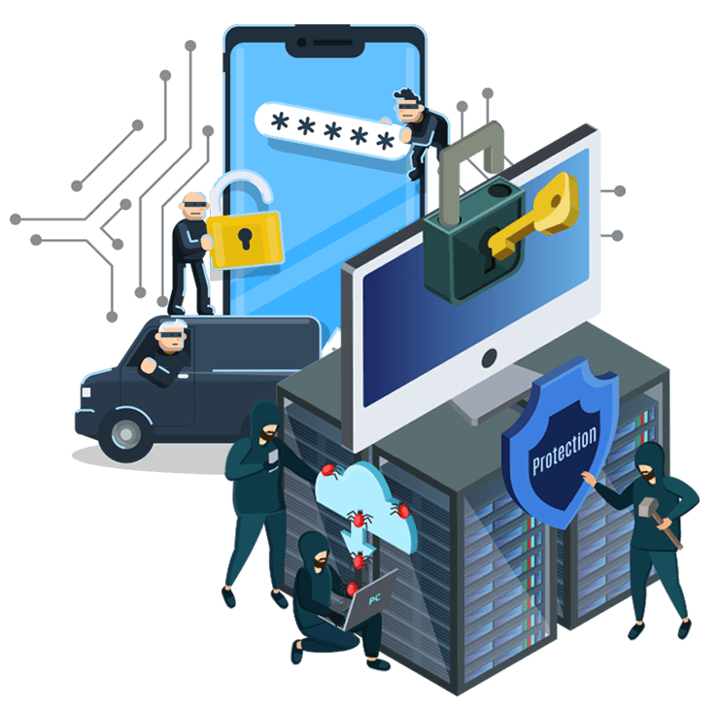
Result Analysis
Safety and Efficiency
Data Integrity and Security
Resource Optimization
Zero Trust Security

Slide 17
Thank you! Please feel free to ask any questions.

